Slide 1
OGC ISG Sprint Kickoff Presentation: Cognitics, Inc.|
Aaron Brinton, VP
September 1, 2020

Slide 2
Background
Cognitics is focused on open-source capabilities supporting interoperability between GEOINT applications and services
CDB Productivity API: open-source libraries and applications for production, consumption, and analysis of CDB content
Rapid3D Capabilities: RESTful microservices utilizing the CDB Productivity API for automated processing of CDB, including translation to OBJ, FBX, 3D Tiles, and I3S.
Inception: open-source Unity3D visualization environment primarily intended as a CDB viewer, but also used for capability prototyping and demonstration

Slide 3
Participation
Participant in the 3D Containers Pilot that produced the draft GeoVolumes API
Provide sample CDB datasets built with open source data
Provide access to developers of the CDB Productivity API for production of OGC CDB standard datasets
Provide 3D visualization of content offered via the GeoVolumes API using Inception
Provide support to other participants as they implement services providing content via the GeoVolumes API

Slide 4
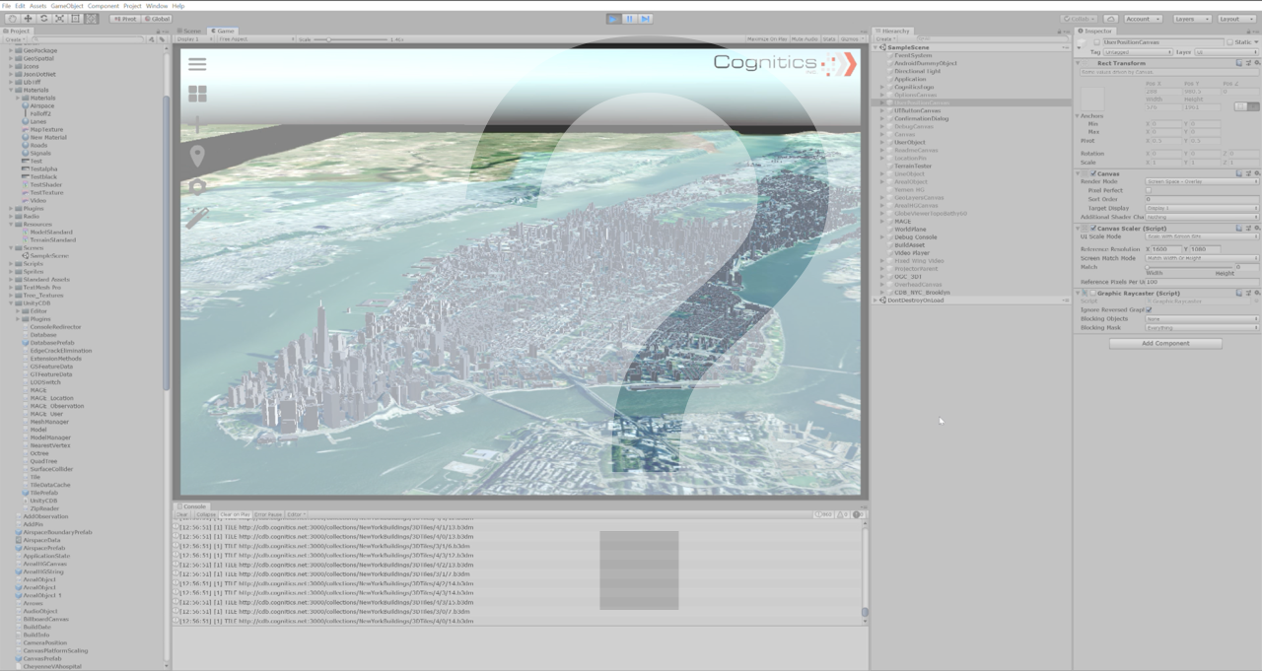
Questions

